Slide 1




Slide 2

Unit 1 : Introduction to AI
Dr. Khushboo Jain
School of Computer Science UPES, Dehradun
India

Slide 3

What is Intelligence

Slide 4
Intelligence refers to the ability to learn, reason, and solve problems.
Or
The ability to solve complex problems or make decisions with outcomes benefiting for others.
For human/animals, problem-solving and decision-making are functions of their nervous systems, including the brain, so intelligence is closely related to the nervous (neural) system.

Slide 5
What is Artificial Intelligence (AI)

Slide 6
AI is a branch of computer science that focuses on creating systems or machines capable of performing tasks that typically require human intelligence.
These tasks include:
Problem-solving
decision-making
Learning
Perception
Language understanding
AI aims to mimic human cognitive functions through the development of algorithms and computational models.

Slide 7
Examples of AI
Here are some common examples of AI in everyday life:
Virtual Assistants: Siri, Alexa, and Google Assistant use AI to understand and respond to voice commands, manage tasks, and provide information.
Recommendation Systems: Platforms like Netflix and Amazon use AI to recommend movies, shows, and products based on your browsing and purchasing history.
Autonomous Vehicles: Self-driving cars use AI to navigate roads, recognize obstacles, and make driving decisions.
Chatbots: Many websites use AI-driven chatbots to provide customer support and answer frequently asked questions.
Image and Speech Recognition: AI powers tools that can identify objects in images or transcribe spoken language into text.

Slide 8
Examples of AI
6. Fraud Detection: Banks and financial institutions use AI to monitor transactions and detect fraudulent activity by recognizing unusual patterns.
7. Language Translation: Services like Google Translate use AI to translate text and speech between different languages.
8. Personalized Learning: Educational platforms use AI to adapt learning materials and exercises based on a student's progress and needs.
9. Healthcare Diagnostics: AI assists in diagnosing medical conditions by analyzing medical images, patient data, and historical health records.
10. Smart Home Devices: AI in smart home devices like thermostats and security systems learns from user behavior to optimize energy use and enhance security.

Slide 9
Key Components of AI
The key components of AI include:
Data: AI systems rely on large volumes of data to learn and make decisions. This data can come from various sources, including sensors, databases, and user interactions.
Algorithms: These are the mathematical and computational procedures used to process data and make predictions or decisions. Common algorithms include machine learning algorithms, optimization techniques, and neural networks.
Models: AI models are created using algorithms and trained on data. They represent patterns and relationships in the data, enabling the system to make predictions or perform tasks based on new inputs.
Training: This involves feeding data into an AI model and adjusting the model's parameters to improve its performance. Training helps the model learn from the data and refine its predictions or decisions.
Inference: After training, AI models are used to make predictions or decisions based on new, unseen data. This process is known as inference and involves applying the learned patterns to real-world scenarios.

Slide 10
Key Components of AI
6. Hardware: AI systems often require specialized hardware, such as GPUs (Graphics Processing Units) or TPUs (Tensor Processing Units), to handle the large computational demands of training and inference.
7. Software: AI software includes frameworks and libraries that facilitate the development, training, and deployment of AI models. Popular examples are TensorFlow, PyTorch, and Scikit-learn.
8. Evaluation: AI systems need to be evaluated to ensure they are performing accurately and reliably. Evaluation metrics help assess the model's performance and identify areas for improvement.
9. Deployment: Once trained and evaluated, AI models are deployed into production environments where they can interact with users and perform their intended tasks.
10. Feedback Mechanisms: These are used to continually improve the AI system by collecting user feedback and updating the model based on new data and insights.

Slide 11

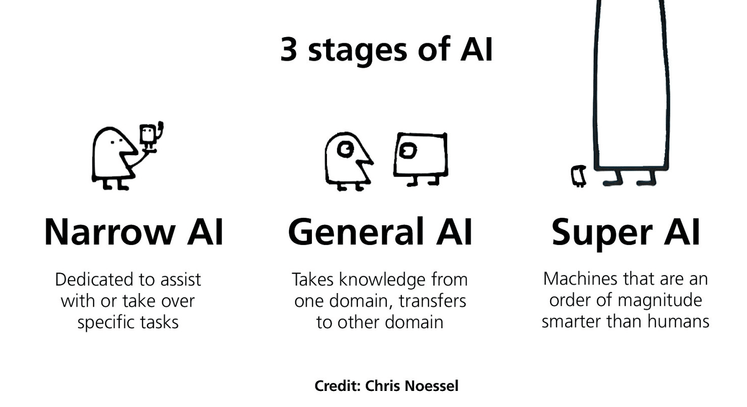
11

Slide 12
Types/Stages of AI
Narrow AI (Weak AI):
Definition: AI that is designed and trained for a specific task or a narrow range of tasks.
Example: Virtual assistants like Siri and Alexa that can perform tasks like setting reminders or playing music.
General AI (Strong AI):
Definition: AI with the ability to understand, learn, and apply knowledge across a broad range of tasks, much like a human.
Example: This level of AI remains theoretical and has not yet been achieved.
Superintelligent AI:
Definition: AI that surpasses human intelligence and capabilities in all aspects.
Example: A hypothetical concept that raises ethical and safety concerns.
12

Slide 13
AI that is designed and trained for a specific task or a narrow range of tasks.
Example: Virtual assistants that can perform tasks like setting reminders or playing music.

Slide 14
AI with the ability to understand, learn, and apply knowledge across a broad range of tasks, much like a human.
Example: Smart cars, games, chatbots, etc.

Slide 15
AI that surpasses human intelligence and capabilities in all aspects.
Example: A hypothetical concept that raises ethical and safety concerns.

Slide 16
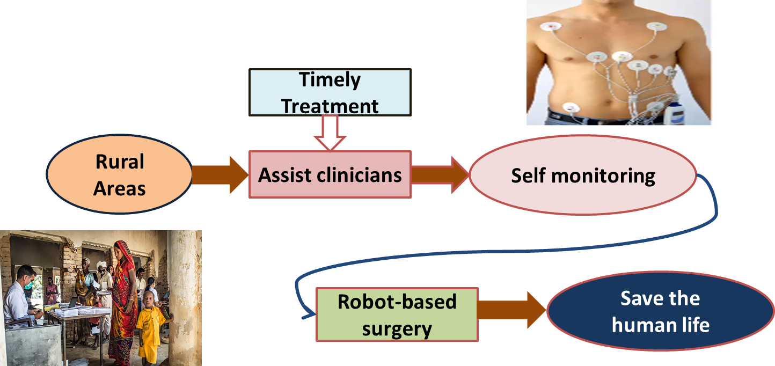
Applications of AI
1. Medical / Healthcare field

Slide 17
Diagnostics: AI assists in analyzing medical images (e.g., X-rays, MRIs) to detect diseases such as cancer or neurological conditions.
Personalized Medicine: AI analyzes patient data to tailor treatments and drug recommendations based on individual characteristics.
Drug Discovery: AI accelerates the process of discovering new drugs by predicting how different compounds will interact.
A medical clinic can use AI systems to organize bed schedules, make a staff rotation and provide medical information.
It also has an application in Image guided surgery and image analysis and enhancement.

Slide 18
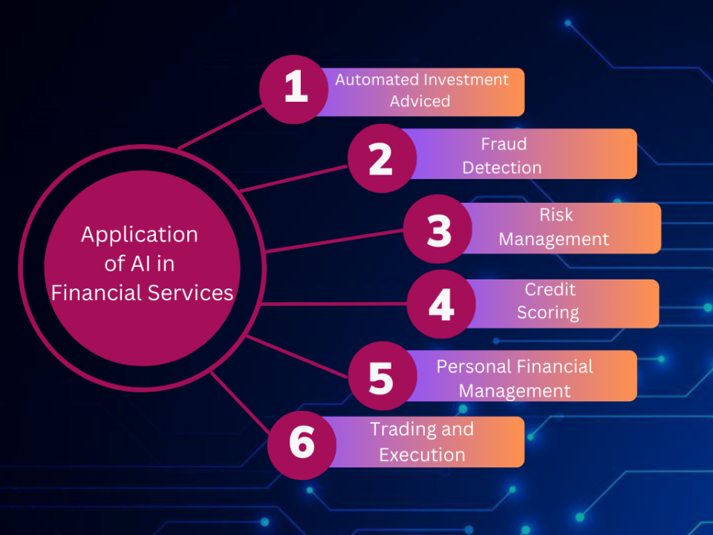
2. Finance

Slide 19
Fraud Detection: AI algorithms analyze transaction patterns to identify and prevent fraudulent activities in real time.
Trading: AI-driven trading systems can process vast amounts of data faster than humans, identifying patterns and making trades at optimal times. Quantitative trading firms extensively use such technologies.
Customer Service: Chatbots and virtual assistants handle customer inquiries and provide financial advice, improving customer service efficiency.

Slide 20
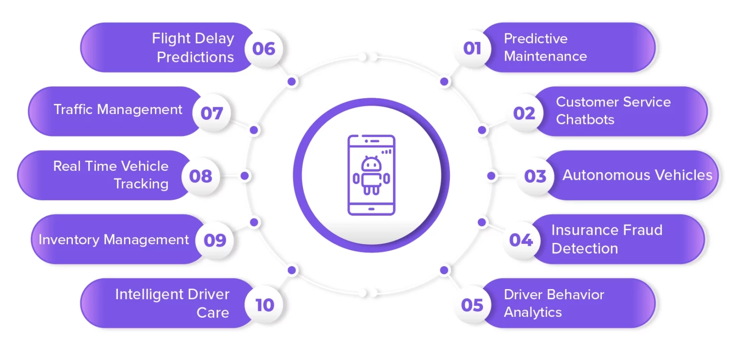
3. Transportation

Slide 21
Autonomous Vehicles: Companies like Tesla and Waymo are developing self-driving cars that use AI to navigate roads, avoid obstacles, and make real-time driving decisions.
Traffic Management: AI systems optimize traffic flow in cities by analyzing data from various sources, reducing congestion and improving transportation efficiency.
Logistics and Supply Chain: AI helps in route planning, demand forecasting, and inventory management, enhancing the efficiency of supply chains.

Slide 22
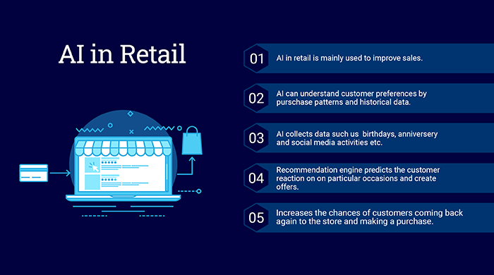

4. Retail

Slide 23
Personalized Shopping Experiences: AI algorithms analyze customer data to provide personalized product recommendations, improving the shopping experience.
Inventory Management: AI systems predict demand trends and manage inventory levels to ensure that products are available when needed without overstocking.
Customer Service: AI-powered chatbots and virtual assistants handle customer inquiries, process orders, and provide support, improving customer satisfaction.

Slide 24
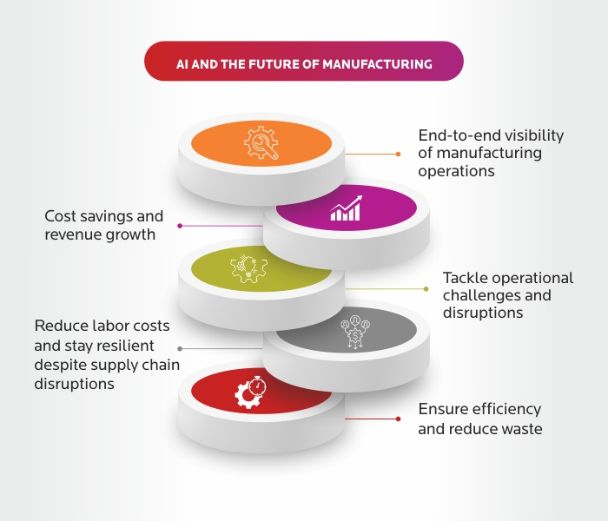
5. Manufacturing

Slide 25
Predictive Maintenance: AI monitors equipment to predict failures before they occur, reducing downtime and maintenance costs.
Quality Control: AI systems inspect products for defects, ensuring higher quality and consistency in manufacturing processes.
Robotic Process Automation: AI-driven robots perform repetitive tasks with high precision, increasing production efficiency and safety.

Slide 26
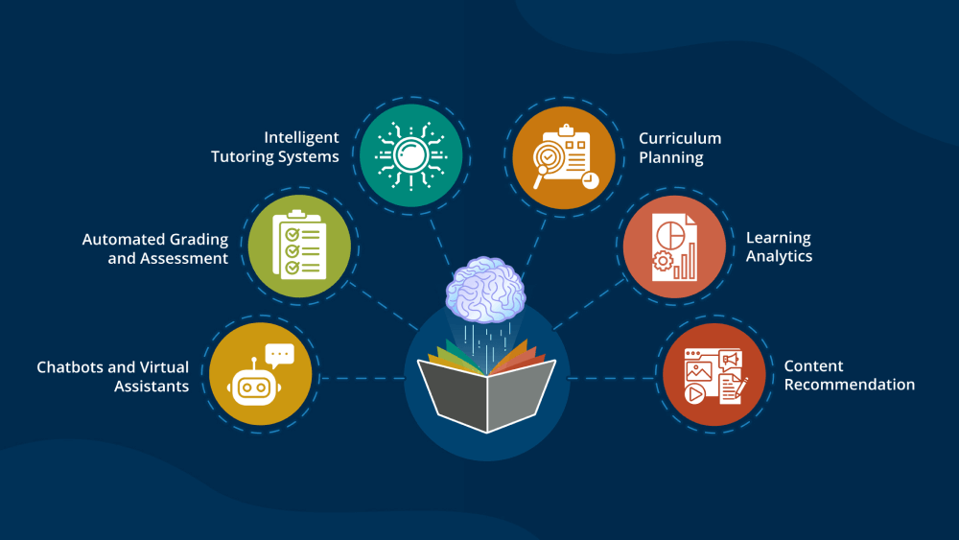
6. Education

Slide 27
Personalized Learning: AI provides customized learning experiences based on individual student needs, preferences, and progress.
Administrative Tasks: AI automates administrative tasks such as grading and scheduling, allowing educators to focus more on teaching.
Virtual Tutors: AI-powered virtual tutors offer additional support to students, helping them understand complex subjects and providing instant feedback.

Slide 28
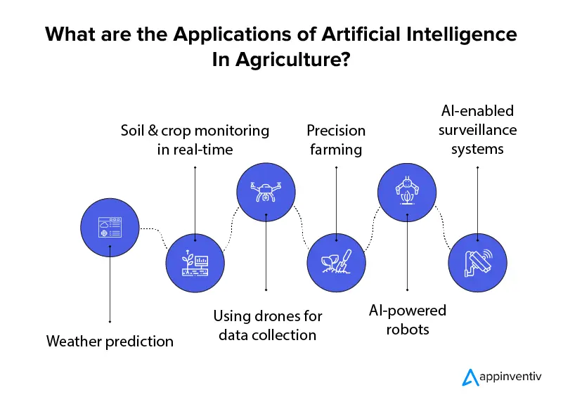
7. Agriculture

Slide 29
Precision Farming: AI analyzes data from sensors and drones to optimize planting, watering, and harvesting, increasing crop yields and resource efficiency.
Crop Monitoring: AI systems detect diseases, pests, and nutrient deficiencies in crops, enabling timely intervention and reducing losses.
Supply Chain Optimization: AI improves the efficiency of the agricultural supply chain by predicting demand and optimizing logistics.

Slide 30
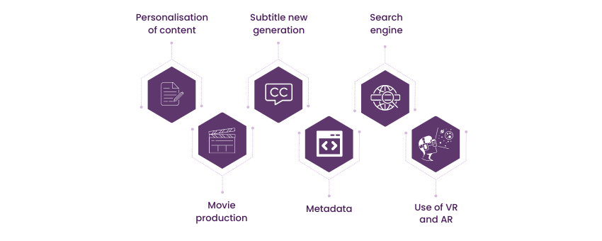
8. Entertainment

Slide 31
Content Creation: AI creates music, art, and literature, pushing the boundaries of creativity. Examples include AI-generated music by Amper Music and AI-written articles by tools like GPT-3.
Personalized Content: Streaming services like Netflix and Spotify use AI to recommend movies, shows, and music based on user preferences and viewing/listening history.
Game Development: AI enhances video game development by creating intelligent NPCs (non-player characters) and procedural content generation.

Slide 32
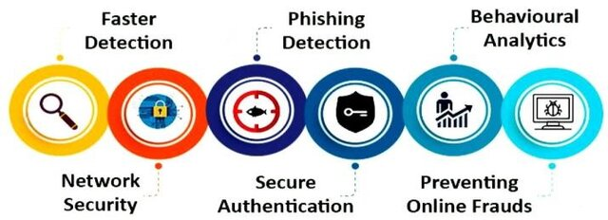
9. Security

Slide 33
Surveillance: AI systems analyze video feeds to detect unusual activities and potential security threats in real time.
Cybersecurity: AI detects and responds to cyber threats by analyzing patterns in network traffic and identifying anomalies.
Identity Verification: AI enhances security in access control systems through facial recognition and biometric analysis.

Slide 34
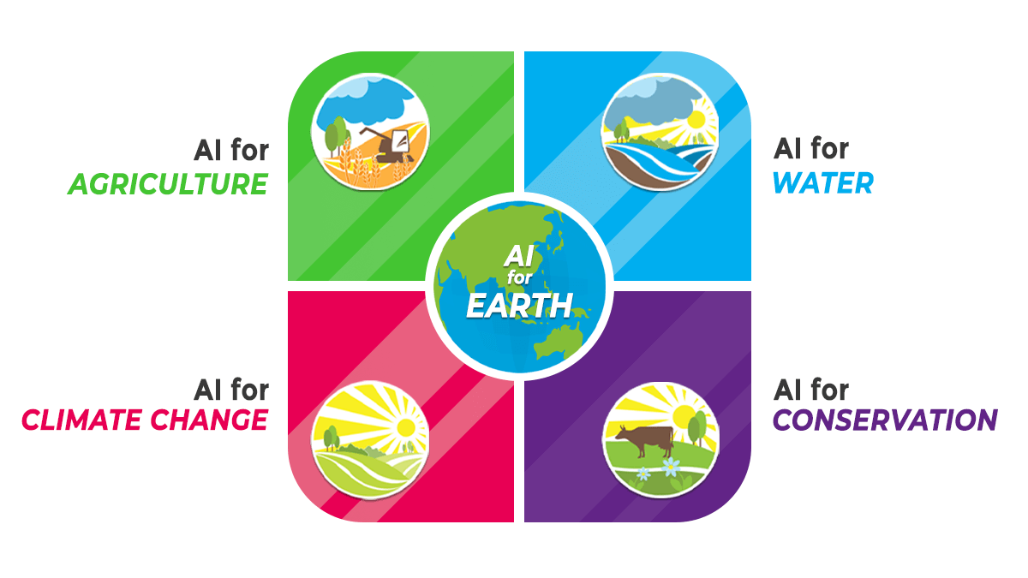
10. Environment

Slide 35
Climate Modeling: AI analyzes climate data to improve weather forecasts and model climate change scenarios.
Wildlife Conservation: AI tracks animal movements and monitors habitats to aid in wildlife conservation efforts.
Energy Management: AI optimizes energy use in buildings and industries, contributing to more sustainable energy consumption.
The applications of AI are vast and continually expanding, transforming industries and improving efficiency, accuracy, and outcomes across various fields.
As AI technology evolves, it is expected to play an even more integral role in solving complex global challenges and driving innovation.

Slide 36
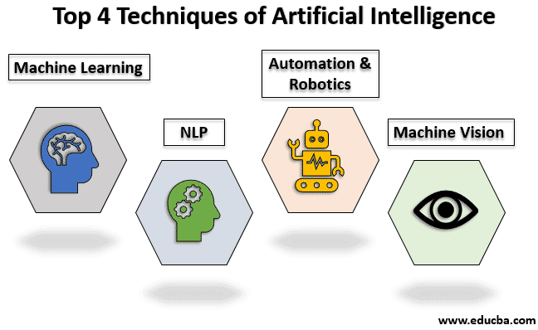
AI Techniques
AI techniques refer to a set of methods and algorithms used to develop intelligent systems that can perform tasks requiring human-like intelligence.
Key Techniques:
Machine Learning
Deep Learning
Natural Language Processing (NLP)
Computer Vision

Slide 37
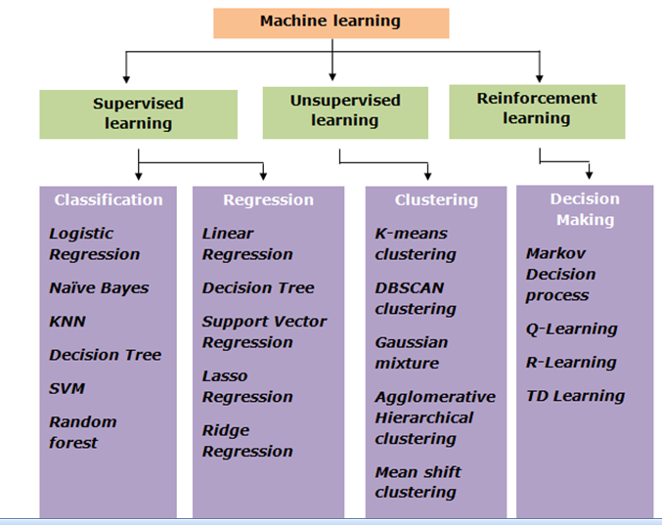
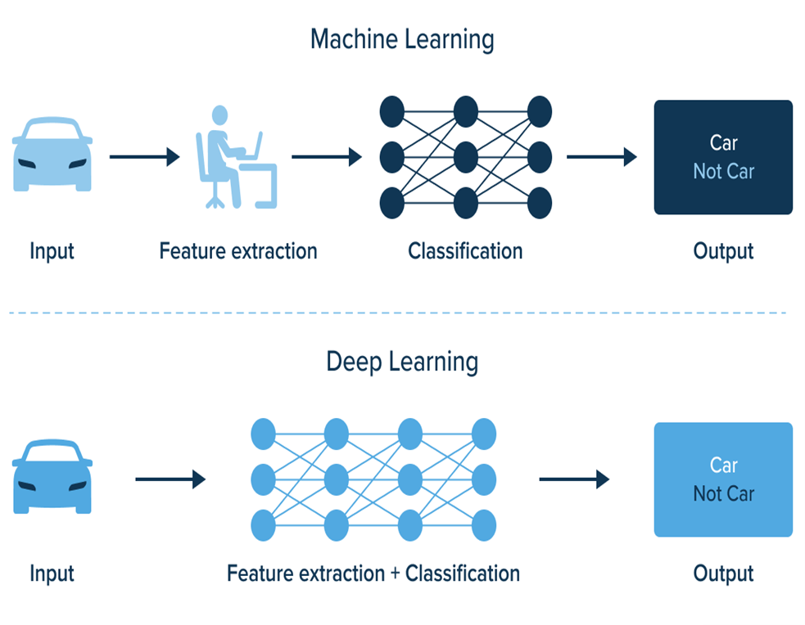
Machine Learning
Machine learning is a subset of AI techniques that involves training algorithms to learn from data.
Types of ML:
Supervised Learning
Unsupervised Learning
Semi supervised Learning
Reinforcement Learning

Slide 38
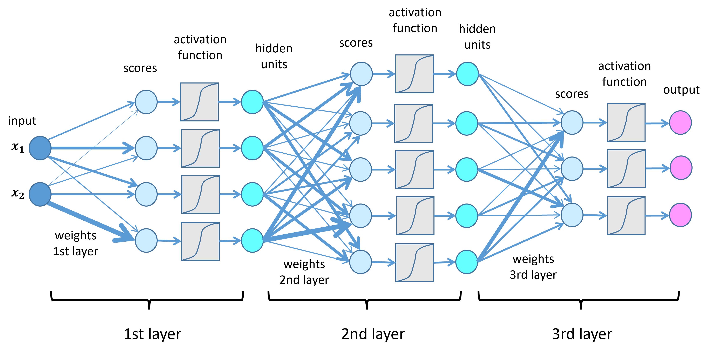
Deep Learning
Deep learning is a specialized form of machine learning that uses neural networks with multiple hidden layers.
Key Concepts:
Neural Networks
Convolutional Neural Networks (CNNs)
Recurrent Neural Networks (RNNs)

Slide 40
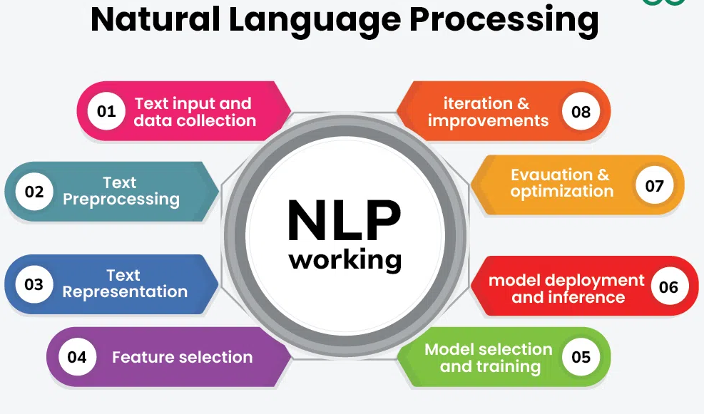
Natural Language Processing (NLP)
Key Techniques:
Tokenization,
Sentiment Analysis
Machine Translation
Applications:
Chatbots,
Language Translation
Text Analytics
Natural Language Processing involves programming computers to process human languages to facilitate interactions between humans and computers.

Slide 41
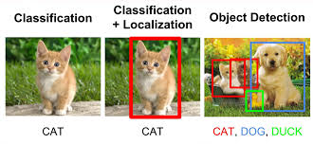
Computer Vision
Computer vision involves teaching machines to interpret and analyze visual information from the real world.
Key Applications:
Image Classification
Object Détection
Image Segmentation.
Summary
AI techniques enable machines to simulate human intelligence.
Machine learning trains algorithms to learn from data.
Deep learning uses neural networks with multiple layers.
NLP enables machines to understand and generate human language.
Reinforcement learning involves an agent learning by interacting with its environment.
Genetic algorithms are inspired by natural selection.
Expert systems emulate human decision-making abilities.
Fuzzy logic handles uncertainty and imprecision.

Slide 42
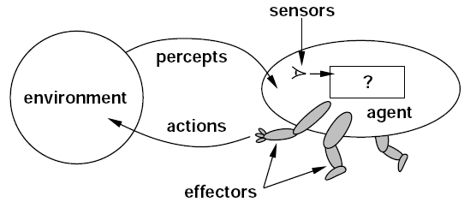
Agents/Intelligent Agents
An AI Agent is a system that perceives its environment, makes decisions, and takes actions to achieve goals.
Core cycle: Perception → Decision → Action → Feedback.
Like a human: See → Think → Do → Learn.
Example: A human agent has eyes, ears, and other organs for sensors and hands, legs, vocal tract, and so on for actuators.

Slide 43
Agents/Intelligent Agents
Everyday Examples of AI Agents
Virtual Assistants: Alexa, Siri – respond to voice commands.
Game AI: Enemies adapting to your moves.
Navigation: Google Maps rerouting around traffic.
Smart Homes: Thermostats adjusting temperature automatically.
Real-World Applications
Healthcare: Monitoring patients with wearables.
Autonomous Cars: Self-driving vehicles reacting in real-time.
Finance: AI agents making stock trades.
Robotics: Amazon warehouse robots managing packages.

Slide 44
Agents/Intelligent Agents
A robotic agent might have cameras and infrared range finders for sensors and various motors for actuators.
A software agent receives keystrokes, file contents, and network packets as sensory inputs and acts on the environment by displaying on the screen, writing files, and sending network packets.
The agent operates autonomously, meaning it is not directly controlled by a human operator.
Agents can be classified into different types based on their characteristics, such as
reactive or proactive
fixed or dynamic environment
single or multi-agent systems.

Slide 45
Agents/Intelligent Agents
Category | Type | Description | Example
Behavior | Reactive Agents | Respond directly to environment stimuli without long-term planning. | Thermostat, obstacle-avoiding robot
 | Proactive Agents | Take initiative, plan ahead, and work towards goals. | GPS route planner, self-driving car
Environment Handling | Fixed Environment | Operate in a stable, predictable environment. | Chess AI, assembly-line robot
 | Dynamic Environment | Adapt to changing, unpredictable conditions. | Stock trading bot, autonomous drone
Number of Agents | Single-Agent System | Works independently in isolation. | Personal voice assistant (Siri, Alexa)
 | Multi-Agent System | Multiple agents interact/cooperate/ compete within the same environment. | Swarm robotics, online multiplayer game AI

Slide 46
Rules all AI agents must adhere to:
Perception Rule – An agent must perceive its environment using sensors (e.g., camera, microphone).
Decision-Making Rule – Based on perceptions, it must choose an appropriate action.
Action Rule – Use actuators (motors, speakers, software commands) to act on the environment.
Rationality Rule – The agent should always act rationally, aiming to maximize performance or achieve its goals.
Learning Rule – Agents should improve over time by learning from feedback and past actions.

Slide 47
Functions of AI Agents
Autonomy – Operate without continuous human intervention.
Goal-Oriented Behavior – Work towards defined goals (e.g., deliver package, answer query).
Adaptability – Adjust actions based on changes in the environment.
Interaction – Communicate with humans or other agents when needed.
Optimization – Find efficient solutions, balancing accuracy, cost, time, and resources.
Decision Support – Assist humans in decision-making (e.g., medical diagnosis systems).
Learning & Improvement –
A voice assistant (Alexa):
Rules → Listen (sensor), process speech (decision), respond with audio (actuator).
Functions → Works autonomously, adapts to accents, helps users with reminders, learns preferences.

Slide 48
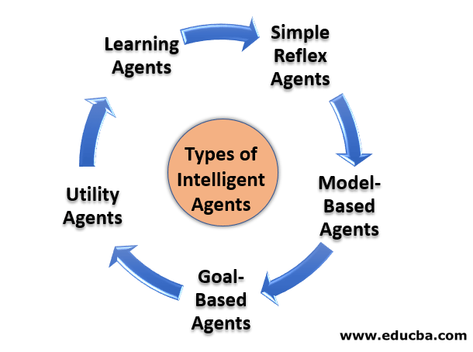
Types of Agents in AI:
Study from this link : https://www.geeksforgeeks.org/agents-artificial-intelligence/

Slide 49
Agents/Intelligent Agents
1. Simple Reflex Agents
Work only on condition–action rules (“if this → then that”).
No memory of the past.
Example: A thermostat – if temperature < 20°C, then turn heater ON.
Limitation: Can’t handle complex scenarios.
2. Model-Based Reflex Agents
Have an internal model of the world to handle partially observable environments.
They use memory to track what’s happening.
Example: A robot vacuum cleaner remembers where it already cleaned and avoids repeating.

Slide 50
Agents/Intelligent Agents
3. Goal-Based Agents
Make decisions by considering goals and planning actions to achieve them.
More flexible than reflex agents.
Example: A GPS navigation system – goal = reach destination, it calculates best route.
4. Utility-Based Agents
Not just about reaching a goal, but choosing the best possible action by maximizing a utility function (happiness, efficiency, profit, etc.).
Example: A self-driving car choosing a route that balances speed, safety, and fuel efficiency.

Slide 51
Agents/Intelligent Agents
5. Learning Agents
Improve performance over time by learning from past actions and feedback.
Have four components: learning element, critic, performance element, and problem generator.
Example: A recommendation system (like Netflix or YouTube) improves suggestions based on your watching habits.
Simple Analogy
Reflex Agent → Student who answers only from rote memory.
Model-Based → Student who remembers past lessons while answering.
Goal-Based → Student aiming to score high by solving carefully.
Utility-Based → Student balancing high marks and finishing exam on time.
Learning Agent → Student who learns from mistakes and does better in the next test.

Slide 52

Advantages of AI
1. Efficiency and Productivity
Automation of Routine Tasks: AI can automate repetitive tasks, freeing up human workers to focus on more complex and creative activities.
24/7 Availability: AI systems can operate continuously without fatigue, providing services and monitoring systems around the clock.
2. Accuracy and Precision
Reduced Errors: AI systems can process large amounts of data with high accuracy, reducing the likelihood of human errors.
Precision in Tasks: In fields like medicine and manufacturing, AI can perform tasks with a level of precision unattainable by humans.
3. Data Processing and Analysis
Big Data Insights: AI can analyze vast datasets quickly, identifying patterns and trends that would be impossible for humans to discern.
Predictive Analytics: AI systems can forecast future trends and outcomes, aiding in decision-making and strategic planning.
52

Slide 53
4. Innovation and Discovery
New Solutions: AI can help discover new solutions to complex problems, such as drug discovery in pharmaceuticals and climate modeling.
Enhanced Creativity: AI tools assist in creative fields by generating music, art, and content, pushing the boundaries of human creativity.
5. Cost Savings
Operational Efficiency: By automating processes and optimizing operations, AI can significantly reduce costs for businesses.
Reduced Labor Costs: AI can perform tasks that would otherwise require a large workforce, leading to labor cost savings.
6. Improved Customer Experience
Personalization: AI enables personalized experiences in retail, entertainment, and online services, increasing customer satisfaction.
Enhanced Support: AI-driven chatbots and virtual assistants provide quick and efficient customer service.

Slide 54
Disadvantages of AI
1. Job Displacement
Unemployment: The automation of tasks traditionally performed by humans can lead to job losses and increased unemployment in certain sectors.
Skill Gaps: There is a growing need for workers to acquire new skills to stay relevant in an AI-driven job market.
2. High Implementation Costs
Initial Investment: Developing and implementing AI systems can be expensive, requiring significant upfront investment.
Maintenance Costs: AI systems require ongoing maintenance, updates, and fine-tuning, adding to operational costs.
3. Ethical and Privacy Concerns
Bias and Discrimination: AI systems can perpetuate and even exacerbate biases present in the training data, leading to unfair outcomes.
Privacy Issues: The use of AI in surveillance and data analysis raises concerns about privacy and the potential misuse of personal data.
54

Slide 55
4. Complexity and Understanding
Lack of Transparency: Many AI systems, especially those using deep learning, operate as "black boxes," making it difficult to understand how they make decisions.
Dependence on Quality Data: AI's effectiveness is heavily dependent on the quality and quantity of data available, and poor data can lead to poor outcomes.
5. Security Risks
Cyber Attacks: AI systems can be vulnerable to hacking and other cyber threats, potentially leading to significant security breaches.
Autonomous Weapons: The development of AI-powered weapons poses significant ethical and security risks.
6. Loss of Human Touch
Impersonal Interactions: Over-reliance on AI for customer service and other interactions can lead to a lack of human touch and personal connection.
Dehumanization: In some applications, the use of AI can lead to the dehumanization of certain processes and interactions.

Slide 56
Limitations of AI
Artificial Intelligence (AI) has transformative potential, but it also comes with several limitations that impact its effectiveness and broader adoption. Here are some of the primary limitations of AI:
1. Data Dependency
Quality of Data: AI systems require high-quality data for training. Poor-quality data, including biased, incomplete, or noisy data, can lead to inaccurate models and flawed outcomes.
Quantity of Data: Many AI models, especially those using deep learning, need large amounts of data to perform well. In domains where data is scarce, this can be a significant barrier.
2. Lack of Generalization
Specific Task Performance: Most AI systems are designed for specific tasks and cannot generalize their knowledge to different contexts or tasks. They excel in narrow applications but struggle with tasks outside their training scope.
Transfer Learning Limitations: While techniques like transfer learning aim to apply knowledge from one domain to another, they are not always effective and require careful adaptation.
56

Slide 57
3. Explainability and Transparency
Black Box Models: Many AI models, particularly deep learning networks, operate as "black boxes" with decision-making processes that are difficult to understand or explain.
Trust Issues: The lack of transparency can lead to trust issues among users and stakeholders, especially in critical applications like healthcare and finance where understanding the rationale behind decisions is crucial.
4. Ethical and Bias Concerns
Bias in AI: AI systems can inherit biases present in their training data, leading to discriminatory outcomes in areas like hiring, lending, and law enforcement.
Ethical Dilemmas: AI poses ethical challenges related to privacy, surveillance, and the potential for misuse, such as autonomous weapons or deepfakes.
57

Slide 58
5. Computational and Resource Intensity
High Computational Costs: Training advanced AI models, particularly deep neural networks, requires significant computational resources, which can be expensive and environmentally taxing.
Energy Consumption: The energy required for training and running AI models can be substantial, contributing to a larger carbon footprint.
6. Security and Privacy Issues
Vulnerability to Attacks: AI systems can be vulnerable to adversarial attacks where small, carefully crafted changes to input data can cause the AI to make incorrect decisions.
Privacy Concerns: The use of AI in data analysis raises concerns about the privacy of individuals, as AI systems can infer sensitive information from seemingly innocuous data.
58

Slide 59
7. Human-AI Interaction
User Dependence: Over-reliance on AI systems can lead to skill degradation in humans and an overdependence on automated systems.
Lack of Common Sense: AI lacks the commonsense reasoning that humans possess, making it difficult for AI to handle unexpected situations or understand context as humans do.
8. Regulatory and Legal Challenges
Regulatory Uncertainty: The fast-paced development of AI technologies often outstrips the creation of relevant regulations and laws, leading to uncertainty and potential misuse.
Legal Accountability: Determining accountability and liability in cases where AI systems make erroneous or harmful decisions is complex and unresolved in many jurisdictions.
9. Economic and Social Impact
Job Displacement: AI and automation can lead to job losses in certain sectors, contributing to economic disruption and social inequality.
Access and Equity: The benefits of AI are not evenly distributed, with advanced AI technologies often being accessible only to large organizations or affluent regions, exacerbating existing disparities.

Slide 60

Thank You

